Slide 1


Team 4
1. Nishit Gaurang Shah 130176217
2. Priyansh Parikh 158341214
3. Yuvraj Singh 156150211
4. Yash Padwani 169914215

Slide 2
Introduction To Club-Hub Web Application

Slide 3
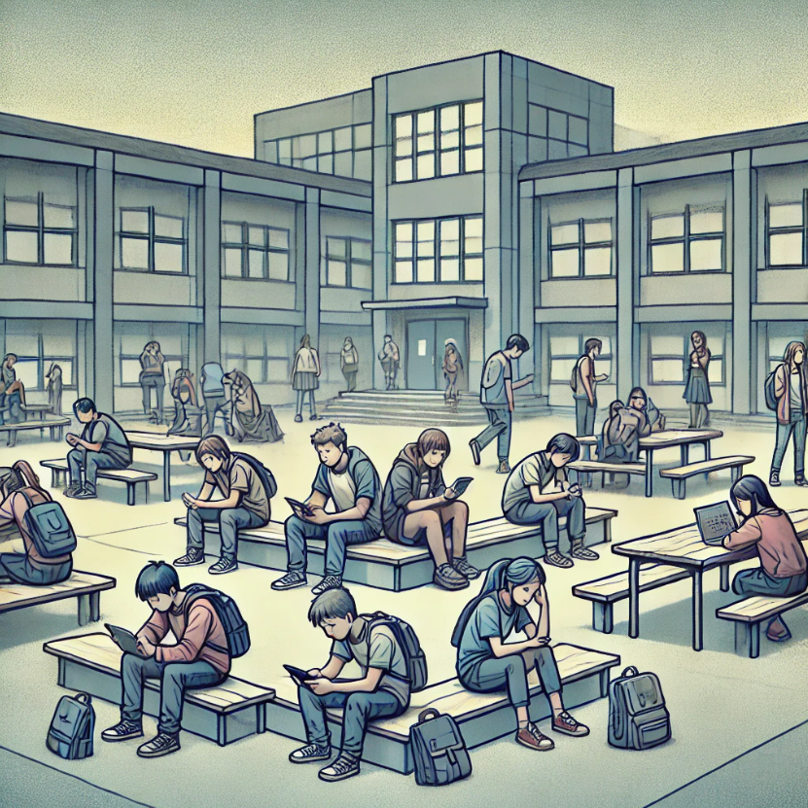
Problem Statement
Limited awareness and accessibility to diverse club activities within Maple Leaf Public School.
This affects students, club organizers, and the school community.
Reduces student engagement, missing opportunities for personal development, and creates a fragmented sense of community.
A successful solution would improve awareness, streamline club participation.
Strengthens the sense of community through enhanced communication and interaction.

Slide 4
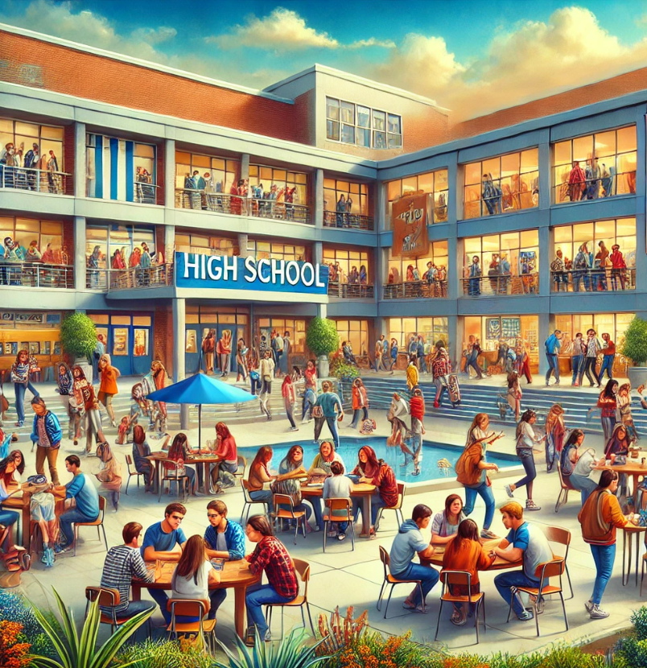
Solution Vision
Club-Hub is a comprehensive web application.
For Maple Leaf Public School students seeking diverse extracurricular experiences.
It centralizes club information, events, and interactions, unlike traditional methods.
Our product provides a user-friendly interface that encourages active engagement.
Fosters a sense of belonging through seamless integration with the school's homepage.

Slide 5
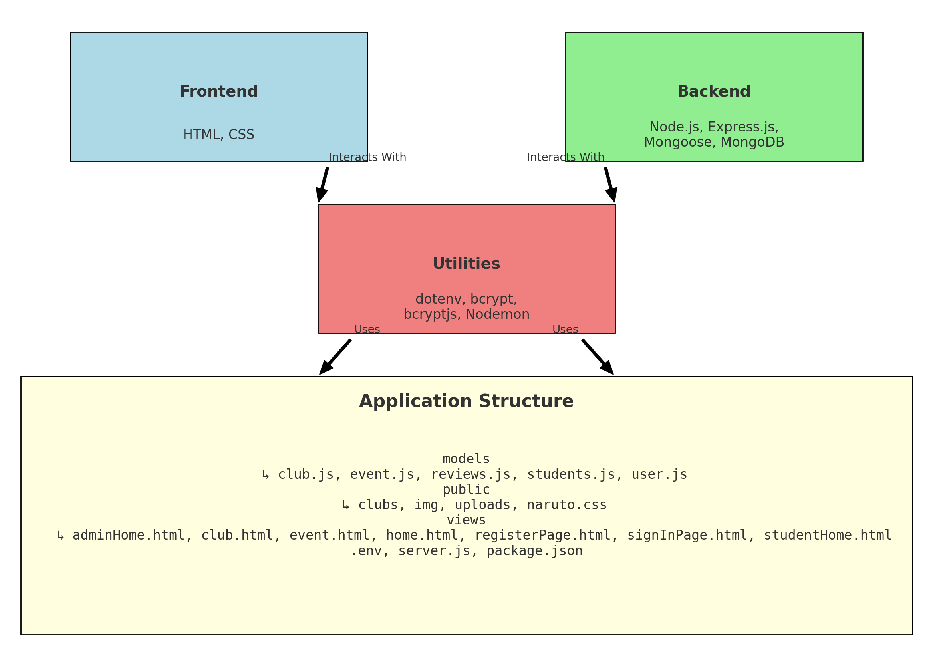
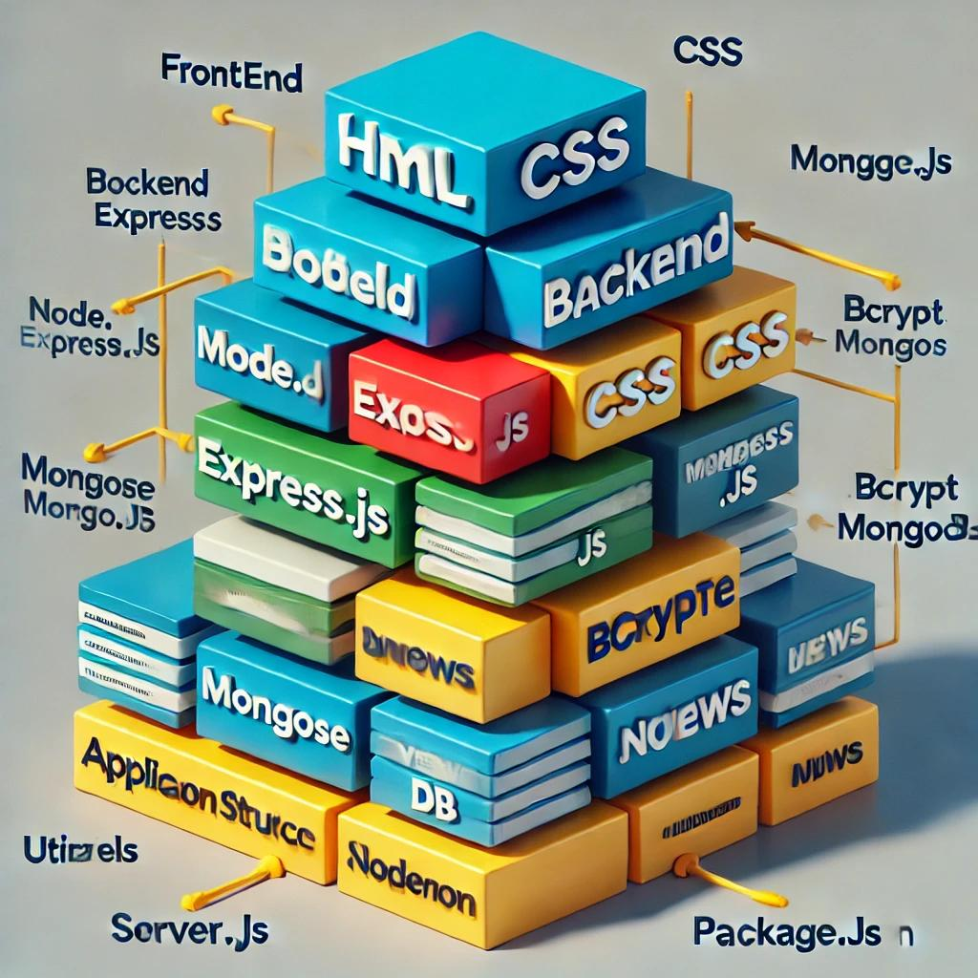
Architectural Description/stack diagram
Technology Stack: Frontend with HTML and CSS; Backend with Node.js, Express.js, and MongoDB via Mongoose; Utilities include dotenv, bcrypt, and Nodemon.
Application Structure: Models for data schema (club.js, user.js), Public for static files (CSS, images), Views for HTML pages (home.html, registerPage.html), Config with .env and server.js.
Component Interaction: Frontend interacts with Backend; Backend utilizes Utilities; Modular design ensures easy maintenance.
Data Flow: Frontend sends requests to Backend, which processes them using Utilities and interacts with MongoDB; Data is then returned to the Frontend.

Slide 6

Summary
1. User Testing and Feedback Gathering
2. Deployment and Launch
3. Post-Launch Support and Maintenance
4. Continuous Improvement and Iteration
5. Community Engagement and Promotion
6. Evaluation and Assessment
7. Stakeholder Communication and Collaboration

